Slide 1
Beazley gpas OPERATING MODEL
Ways of Working for GPAS Programme Delivery
Drafted: Mar-2024

Slide 2
  Document change history
S.No | Version | Month/Date | Changes made
1. | 0.1 | March-2024 | First version of Ways of working, focused more at Inception phase method & processes

Slide 3
CONTEXT
Ways of working is a Capgemini recommended way of Program execution allowing all relevant parties and stakeholders to operate and collaborate towards achieving the common program goals. This document intends to target both processes and behaviours that form the building blocks of successful completion of GPAS
This Ways of working is specifically designed for GPAS only and for the scope of work owned by Capgemini. The processes, behaviours and recommendations outlined here may not be applicable outside GPAS to the wider Modernization program
The Ways of working document is expected to evolve iteratively, through Inception phase before it can be made final. However, throughout the GPAS program execution, the delivery method or process may undergo change in certain sections if all the influenced parties agree there is a need for improvement

Slide 4
Ways of working
The immediate focus is to draft and agree on a Ways of working applicable for the start of Inception phase. As a next step, Ways of working will be extended to document methods and processes applicable to the Build phase.
To be built & agreed for start of Inception
INCEPTION PHASE
Scope of Inception phase
Key Success factors
Inception activities – week wise split
Workshops – rules of engagement
Key roles – Beazley and Capgemini
Team Structure for Inception
Design Principles
Inception phase deliverables
RACI
Governance – Key roles, Cadence, Escalation, Change Control
Tools for Inception
JIRA set-up and governance
BUILD PHASE
To be built & agreed in parallel to Inception for start of build
  Foundation & Waves Construct
  Backlog management process
  Sprint construct
  Cadence and ceremonies
  User story management
  Activities list
  DoD and DoR - Definition of Done and Definition of Ready
  Third party alignments and SLA
  Metrics & Reporting
  Collaboration and Tool sets

Slide 5





Programme Inception phase helps create the foundation & vision of the Transformation
A common 12-weeks Programme Inception phase to clarify and align the scope in all Products for a Foundation,
followed by the implementation of the planned Releases.
Programme Inception
Design and Build
Programme Inception is focused on “Designing the next winning proposition”
Foundation Release Mobilization is focused on enabling MVP Design and Build to start
Build the foundation with core principles intact. – data/ automation / experience
Collaborative pre-work on entry criteria to ensure rapid start and timely completion
Transform the plan from the Inception to reality, transforming the business requirements to functional systems
Plan for future Releases and LOB
Confirm Roll-out Approach
What you’ll get:
Prioritized backlog
High Level Design
Foundation release plan
Key risks & assumptions
Dependencies detailed

Slide 6

KEY SUCCESS FACTORS
Right Time
  Multi-day sessions
  Aligned workshops
  Covering India, UK and US time zone
Outputs more focused at Foundation release
GPAS Ways of working
Prioritized Backlog
Effort & Resourcing
GPAS HLD and Delivery Plan
Migration Strategy
Integration Inventory
Dependency tracker
Test Strategy
Rationalized Product set for
Pebbles / Rocks / Boulders
Categorizing elements of solution for appropriate escalation to finalise scope
Right Inputs
  Product / Process Design
  OOTB Guidewire Process Flows
  Interfaces
COLLABORATION
AGILE
MATURITY
Right Team
  Product Owners, Business SME
  Right Capgemini team
  Collaboration is key
DEPENDENCIES MANAGEMENT
Right Enablers
  Guidewire Instance
  Collab Tools
  Reliable access to VDIs
Right Decisions
  Timely & accurate decisions
  On time escalations for help
  Lean thinking
Inception Phase Principles
OOTB Conformance
Business Priority / Rationale
Design for Future

Slide 7
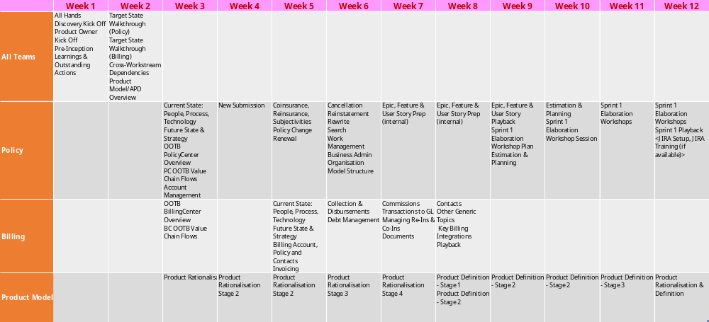
INCEPTION PLAN – By WEEK BREAKDOWN
The Inception plan will be shared separately for Beazley’s review and preparation for start
Workshops - Tuesday, Wednesday, Thursday
(AM: 10-12:30
PM-13:30-17:00)

Slide 8






Guidelines for meetings and workshops
Rules of Engagement
  All meeting and workshop invites to include:
    Purpose of the meeting / Agenda
    Input to the meeting
    Expected output from the meeting
    Deliverable(s) output (as required)
  Be straight and transparent
  Business attendees and availability to be confirmed by Beazley (Senior Product Owner/relevant Product Owner) before invitation is sent
  Parking lots/Decision logs to be captured and logged in the required trackers
  Critical decisions to go through appropriate Programme Governance forums and documentation
  On site and remote attendance options to be available
  Recording of sessions to be used where appropriate
  All sessions to be aligned to overall programme strategy
  All material to be utilised for Beazley programme purposes only
Notes:
3 mins
Cloud Assurance – feedback highest standard of code globally. Jointly work with them
GW embedded within the team
Fully connected Delivery teams
Clear points of escalation
Lean/Scalable governance model

Slide 9
Inception programme deliverable outputs
Deliverables at programme level & expected signatories
Deliverables to be produced during Inception, ready for review and response feedback loop. All deliverables to have a wider review distribution which will be confirmed on the deliverable itself.
Functional Activities
Obtain an understanding of in scope functional areas
Obtain and understanding of as is current processes
Receive demos of current systems
Review the existing capability map and identify any gaps
Deliverable Names | High level Description and Expectation | Sign Off
PD1: GPAS Ways of Working | Detailed methodology, Governance model, Change control model, communication management, Reporting & meeting cadence, Initial team structure, RACI, Escalation approach, Tools for build & usage boundaries | Warren Pilkington Stephen Payne Troy Baillargon
PD2: Prioritized Backlog (Foundation) | Documentation of Foundation Release Functional requirements, in scope Epics/Features. User Stories scope statement defined in excel format for uploading into JIRA | Jeff Colandrea Matt Reynolds
PD3: Resourcing & Efforts (Foundation) | Breakdown of resourcing needs (by quarter) aligned to effort and bottom-up estimation of Epics and Features against the delivery plan. High level scope, budget, and resourcing/effort should reconcile. | Programme Leadership team
PD4: Delivery Structure & Plan (Foundation) | Phase & Workstream definitions, objectives and milestones. Verification and Acceptance. Plan detailing the Guidewire sprint plan, number of sprints, dates, and high-level proposed scope breakdown. | Warren Pilkington Athik Miah
PD5: GPAS High Level Design | Aligned to agreed architecture decisions and principles Detail how Policy and Billing Center will fit into Beazley ecosystem. Detail the key Integrations for the Foundation release | Dean Johnston Matt Reynolds
PD6: Migration Strategy | Approach to migration in terms of execution and timing. High-level data requirements at an entity level, from relevant business areas. | TBD
PD7: Integration Manifest | Inventory of integrations defining cardinality, service contract ownership, integration pattern or method, initial view on complexity. Definition of any intermediated services or gateways to influence design. | TBD
Notes:
3 mins
Cloud Assurance – feedback highest standard of code globally. Jointly work with them
GW embedded within the team
Fully connected Delivery teams
Clear points of escalation
Lean/Scalable governance model

Slide 10
Inception programme deliverable outputs
Deliverables at programme level & expected signatories
Functional Activities
Obtain an understanding of in scope functional areas
Obtain and understanding of as is current processes
Receive demos of current systems
Review the existing capability map and identify any gaps
Deliverables to be produced during Inception, ready for review and response feedback loop. All deliverables to have a wider review distribution which will be confirmed on the deliverable itself
Deliverable Names | High level Description and Expectation | Sign Off
PD8: Detailed Dependency Tracker | Internal and External Dependencies detailed with dates and deliverables agreed with each of the related parties. | Warren Pilkington
PD9: Functional & Technical Principals | Functional and Technical Design principles documented. | Dean Johnston Matt Reynolds
PD10: GPAS Test Strategy | High level scope of key test phases, gates and entry/exit criteria; view of resourcing. Input into Definition of Done (DoD) including acceptance criteria, automation definition. Definition of the GPAS environment requirements and when they will be required by to meet the timelines. | TBD
PD11: Product Set | Rationalised product set for foundation release Identification of any products requiring further analysis and key decision papers where necessary. | Warren Pilkington
Notes:
3 mins
Cloud Assurance – feedback highest standard of code globally. Jointly work with them
GW embedded within the team
Fully connected Delivery teams
Clear points of escalation
Lean/Scalable governance model

Slide 11
Team Structure for inception
Beazley
Capgemini
Business Sponsors / Delivery Executives
Barry Houston
Vanesssa Ortega
Akhlas Hafiz
Programme Directors
Max Cartwright
Warren Pilkington
Delivery Leads
Ananda Arasu Ponnaiah
Natraj Gudla
Athik Miah
(BC)
Product Owner
Jeff Colandrea
(Core)
Devin Wells
(CIPS)
Abby Vredenburg
(Op)
Troy Baillargeon
(Change)
Functional Leads
Sherezad Contractor
(PC)
Sriram Jagannathan
(BC)
Subject Matter Experts
Patrycja Kuligowska
(BC)
Stephen Payne
(GPAS)
Architects
Brett Fabian-Smith
Jigar Solanki
Dean Johnston
Matt Reynolds
Technical Leads
Vamshi Chennamadhavuni
(Guidewire)
Rajesh Bandaru
(PC)
Gourab Marik
(INT)
Balaji KV
(BC)
Test Manager
SivaramaKrishna Narayanan
TBD
Product Rationalization
Peter Dixon
Kelly Reisling
Jeff Colandrea
(Core)
Troy Baillargeon
(Change)
Matt Reynolds
Procurement
Ian Craney
Ben Lowles

Slide 12
Design principles
All key decisions to move through formal programme governance decision bodies
Does the decision:
Decision making process:
support the agreed Release scope?
Workshop/Meeting where key question arises
ensure the business is not in a worse position from before?
Identification of key decision needed, decision owner and required inputs to enable decision
Creation of key decision paper and supporting material(s)
support a move off existing systems
Presentation at BDA/TDA or both as required
support flexibility and maintainability for future releases?
BDA/TDA decision output documented and stored
abide by the Beazley architectural principles?
Ratification of BDA/TDA decision output at Programme Leadership/Steering if required
allow for scalability and is not closed off for future-states
Notes:
3 mins
Cloud Assurance – feedback highest standard of code globally. Jointly work with them
GW embedded within the team
Fully connected Delivery teams
Clear points of escalation
Lean/Scalable governance model

Slide 13
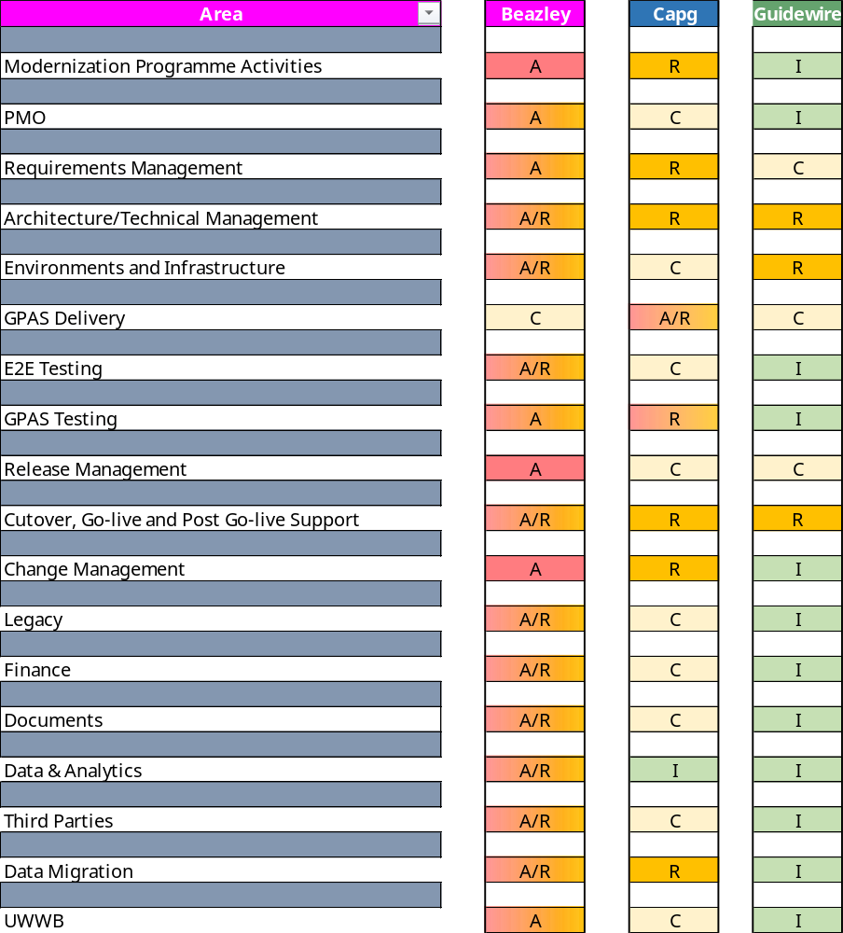
KEY AREAS - raci
RACI will also be broken down further into detailed responsibility lines.
Key
A | Accountable | Authority and decision making
R | Responsible | Responsible for actualisation of the task
C | Consulted | Engaged stakeholder, consulted in decisions, delivery and approach to enable their input
I | Informed | Informed stakeholder receiving updates and outputs only
Notes:
3 mins
Cloud Assurance – feedback highest standard of code globally. Jointly work with them
GW embedded within the team
Fully connected Delivery teams
Clear points of escalation
Lean/Scalable governance model

Slide 14
KEY ROLES – Beazley
Role | Named Resource | Responsibilities
Business Owner/ Sponsor | Vanessa Ortega | Approve scope, target design and execution plans for the PAS iniaitive. Accountable for delivery against OKRs, business outcomes and benefit realisation. Commits or helps facilitate appropriate resources (e.g. SMEs) and support issue resolution for the PAS initiative. Approve and oversee key initiative decisions as adviser Steer solution design and build based on business needs
PAS Delivery Lead | Warren Pilkington Athik Miah | Develop the initiative objectives, scope, highlevel implementation roadmap, resource requirements and investment estimates. Working with the delivery partners, create and manage the PAS delivery plans. Manage the delivery teams inc. resource management, supply & demand, technical capability and skills Manage inbound and outbound dependencies needed for the delivery of the component Management of risks and issues impacting progress Responsible for status reporting of the project
Global PAS Product / Platform Lead | Stephen Payne | Helps define the PAS Product Strategy, Vision and Roadmaps alongside the Product Owners in the PAS initiative. Managing and prioritising the PAS Portfolio Backlog taking care to ensure alignment with business architecture, data teams and existing BAU environments. Delivering Value by ensuring the PAS solutions are complete from the user perspective (including operations, change etc) and deliver meaningful business value. Point of escalation and coaching for squad-level Product Owners.
Solution Architect Lead | Dean Johnston Matt Reynolds Steve Enness | Work with squads to define target technical solutions. Gain approval through Design Authority for technical solutions. Monitor technical risk and mitigation control. Define technical guardrails for delivery squads. Embed technical work into backlogs of delivery squads.
Product Owner | Jeff Colandrea Devin Wells | There will be different Product Leads depending on the release/wave of PAS implementation. For example, Cyber and D&O in Foundation release. Understand and be able to describe the end-to-end solution in a high level, the use cases and related business drivers. Attend decision making sessions, feeding input regarding the product and its interaction with other components, acting as a point of reference for the product required features and behaviour. Understand business demands and requirements and translate these into solutions that are refined iteratively and present them to the team. Prioritise requirements of the product and make adjustments as needed after each release. Define the future goal of the product (the ‘product vision’) Maintain and own the product backlog. Accepting or rejecting suggested improvements. Report progress, involvement in governance arrangements.
Scrum Master | TBD | Responsible for the effective and consistent operational performance for the scrum process. Responsible for both timely and effective tracking and reporting on team progress against goals. Responsible for managing team capacity, utilisation and velocity. Responsible for providing Delivery Lead and Product Owners with relevant input for each team member to support each team member’s development and performance needs.
Notes:
3 mins
Cloud Assurance – feedback highest standard of code globally. Jointly work with them
GW embedded within the team
Fully connected Delivery teams
Clear points of escalation
Lean/Scalable governance model

Slide 15
KEY ROLES – Beazley
Role | Named Resource | Responsibilities
Quality Assurance Testing Lead | TBD | Ultimately accountable for the quality of the overall end to end solution Provides overall QA oversight for test design and execution, striving for commonality where appropriate Accountable for defining Program level test strategies and approaches for all test phases Accountable for planning and oversight of all test phases, including UAT Provides testing oversight and direction, drives execution of testing strategies and manages testing related objectives and issues across the Program
Release Train Engineer/ Manager | Stephen Payne Marta Latuszek | Partnering with Product Manager Assisting in management of risks, issues and any potential roadblocks Responsible for resolving contingencies and complicated issues, provide leadership to project teams, and act as a consultant/coach to management Responsible for DevOps and improvement of workflow
Business Architecture Lead | Dean Johnston | Accountable for developing the business architecture strategy Applying structured business architecture approach and methodology Drives and facilitates the right discussions with business leaders to identify business capabilities in relation to current and future business objectives Responsible for presenting recommendations and solutions clearly and concisely Accountable for a specific LOB, business pillar or multiple segments, and high level of complexity and attributes
Change Management Lead | Troy Baillargeon | Responsible for managing all types of change Evaluates the impact of change Supports development of communications relevant to change initiatives Accountable for defining success metrics and measuring performance against these
Training / Communication | Lewis Claxton | Coordinating the development, execution, refinement, and measuring the impact of programme outreach, communications, and knowledge management strategies Responsible for coordinating development of training / learning materials Accountable for the organisation, coordination of workshops and events Responsible for supporting communications, knowledge management, and training activities
Delivery Partners (Third party suppliers to Beazley) | TBD | Partner with the Senior Delivery Lead Manage the scope of services in support of delivering the PAS initiative Manage the deliverables to be produced in support of delivering the PAS initiative Manage any CRs related to the component and services being provided in support of delivering the PAS initiative Create and manage the plans for the delivery of the services in support of the PAS initiative Manage the delivery squads inc. resource management, supply & demand, technical capability and skills Jointly manage sprint planning, retrospectives and reporting relating to services being provided in support of delivering the PAS initiative Manage inbound and outbound dependencies needed for the delivery of the component Coordinate activities and schedule across the PAS initiative Management of risks and issues impacting progress
Delivery Squads (Beazley SME and/or Third party suppliers to Beazley) | TBD | End-to-end delivery of each product Provide requested SME input into tasks, activities, decisions Flag risks and issues to the Senior Delivery Lead and/or Delivery Partner Proactive updating of Jira, the backlog and the sprint boards in conjunction with the scrum master
Notes:
3 mins
Cloud Assurance – feedback highest standard of code globally. Jointly work with them
GW embedded within the team
Fully connected Delivery teams
Clear points of escalation
Lean/Scalable governance model

Slide 16
KEY ROLES - capgemini
Role | Named resource | Description
Delivery Executive | Barry Houston | Responsible for overall Services quality and delivery Assist in the resolution of issues and change controls | Prepare for and support Steering/Policy Executive Advisory Group Meetings Monitor program progress
Program Director | Max Catwright | Responsible for in-scope Program activities Provide Program status reporting on a regular basis to Beazley Program and Executive Leadership | Responsible for overall Services quality and delivery of the Program Responsible for day-to-day management and tracking of the in-scope Program activities
Engagement Manager | Ananda Arasu Pommaiah | Manage the detailed Program plan in collaboration with Beazley Leadership Team Provide Program Status reporting on a regular basis to Beazley Program Leadership | Facilitate Decisions, Issues and Risk management across the core program and escalate to Beazley in advance of the materialization of potential risks and issues that may delay the program. Assist the resolution of issues and change controls
India Delivery Executive | Natraj Gudla | Manage the detailed Program plan in collaboration with Beazley Leadership Team Provide Program Status reporting on a regular basis to Beazley Program Leadership | Facilitate Decisions, Issues and Risk management across the core program and escalate to Beazley in advance of the materialization of potential risks and issues that may delay the program. Assist the resolution of issues and change controls
Product Rationalisation | Peter Dixon Kelly Riesling | Provide subject matter specialist advice with regard to overall business requirements and product backlog Provide input on solving business problems within the defined application landscape by working with the business and Technical resources. | Coordinate with Functional Lead and Technical architect to help define implementation scope of work.
Enterprise Architect | Brett Fabian-Smith | Provide leadership and architectural expertise across a broad set of technologies, including integration & middleware technologies Consult with and advise the Program team on technology and strategic decisions | Identify architectural constraints for the architectural level (project, domain, application) based on technical and organizational requirements Provide subject matter specialist advice with regard to overall solution architecture and technology
PolicyCenter Functional Lead | Sherezad Contractor | Provide Policy subject matter experience Work with Beazley business leadership to drive overall business requirements | Provide leadership and direction for elaboration and RSWs Provide joint review and approval of deliverables
BillingCenter Functional Lead | Sriram Jagannathan | Provide Billing subject matter experience Work with Beazley business leadership to drive overall business requirements Provide leadership and direction for elaboration and RSWs | Provide joint review and approval of deliverables Lead with the high-level implementation approach for complex functional requirements
PolicyCenter Technical Lead | Vamshi Chennamadhuveni | Provide subject matter specialist advice with regard to GW PC Conduct configuration option analysis to support business requirements Provide input on GW PC best practices, constraints, and effort during workshops, including pre-work | Provide input on effort and impact associated with potential configurations/customizations Support the Policy Functional Lead with the high-level implementation approach for complex functional requirements
BillingCenter Technical Lead | Sriram Jagannathan | Provide subject matter specialist advice with regard to GW BC Conduct configuration option analysis to support business requirements Provide input on GW PC best practices, constraints, and effort during workshops, including pre-work | Provide input on effort and impact associated with potential configurations/customizations Support the Policy
Integration Lead | Saharsh Gupta Gourab Marik | Provide integration and technical architecture guidance for GW Lead analysis effort of interface specification documents | Lead the integration design effort for specified integration points Provide direction and technical guidance
Notes:
3 mins
Cloud Assurance – feedback highest standard of code globally. Jointly work with them
GW embedded within the team
Fully connected Delivery teams
Clear points of escalation
Lean/Scalable governance model

Slide 17
KEY ROLES - guidewire
Role | Named resource | Description
PolicyCenter Principal Architect | TBD | PolicyCenter technical architect
PolicyCenter Principal Business Analyst | TBD | PolicyCenter functional and product expert
BillingCenter Principal Architect | TBD | BillingCenter architect
Integration Principal Architect | TBD | Guidewire Integration architect
London Market Specialist | TBD | Guidewire London Market and product architect
Guidewire Delivery Management (non-billable part time role) | TBD | Guidewire point of contact for the implementation and Guidewire assigned resourcing.
Guidewire Product (non-billable part time role) | TBD | Guidewire London Market expert and point of liaison with Guidewire product team. Needs to understand the business needs so that any future Guidewire product related enhancements can be planned.
Guidewire Product (non-billable part time role) | TBD | Guidewire London Market expert and point of liaison with Guidewire product team. Needs to understand the business needs so that any future Guidewire product related enhancements can be planned.
Notes:
3 mins
Cloud Assurance – feedback highest standard of code globally. Jointly work with them
GW embedded within the team
Fully connected Delivery teams
Clear points of escalation
Lean/Scalable governance model

Slide 18
governance
The overall success of this engagement will be based on close collaboration between all parties, transparency and fact-based decision making. We will also use this Governance process to keep us all collectively honest and true to the Programme objectives.
Monthly/Quarterly
SteerCo
Reporting
Decisions
Sponsor Review
Change Control Board
Weekly
Leadership Update
Reporting
Technical Design Authority
Business Design Authority
Decisions
Procurement Update
Weekly
Dependency Review Forum
GPAS Programme Management Update
RAID Review
Daily
Agile – Daily Stand-up / Scrum of Scrums
Notes:
3 mins
Cloud Assurance – feedback highest standard of code globally. Jointly work with them
GW embedded within the team
Fully connected Delivery teams
Clear points of escalation
Lean/Scalable governance model

Slide 19
Key
Daily | Weekly | Fortnightly | Monthly | Quarterly
Proposed Programme CADENCE
Daily meetings are reduced timeslots
Steering Committee^{1 –} Usually the last 2 weeks of the month, day and timings can vary
Sponsor Review^{1 –} Occurs every month excluding Steering Committee months
Scrum of Scrums, Dependency Forum and Change Board to start in Inception
Monday
Tuesday
Wednesday
Thursday
Friday
9.00 – 9.30
10.00 – 10.45
11.00 – 12.00
12.00 – 13.00
13.00 – 14.00
14.00 – 15.00
15.00 – 16.00
16.00 – 17.00
Daily Standups
Daily Standups
Daily Standups
Daily Standups
Daily Standups
Scrum of Scrums
Scrum of Scrums
Scrum of Scrums
Scrum of Scrums
Scrum of Scrums
Leadership Stand-Up
Procurement Update
Business Update
PMO RAID review
Dependency Forum
Change Board
Technical Design Authority
Business Design Authority
Steering Committee¹
Programme Management Update
Sponsor Review²
Notes:
3 mins
Cloud Assurance – feedback highest standard of code globally. Jointly work with them
GW embedded within the team
Fully connected Delivery teams
Clear points of escalation
Lean/Scalable governance model

Slide 20

Escalation process
Executive Level:
Escalation Etiquette:
Other key stakeholders:
Business Sponsor
Delivery Executive
Account Executive
Escalations
Decisions / Actions
Escalations are done jointly from Capgemini and Beazley representatives from one level to Capgemini & Beazley representatives at the next level up.
Prior to escalation, representatives will work together to:
Agree what they agree on
Agree what they disagree on
Prepare for the escalation, making clear:
  The problem statement
  The options for resolution and their pros and cons
  The decision(s) and / or action(s) required
  The date required by
  The impact of doing nothing / missing the date
Finance modernisation
Underwriting & Servicing
Data Migration
Operations
Programme Director
Programme Director
Delivery Lead
Delivery Lead
Product Owner
Functional Lead
Project Team:
Business SMEs, Business Analysts, Architects, Engineers, UAT team etc.
Business Analysts, Architects, Designers, Engineers, QA / Testers, DevOps, Scrum Masters, Data Scientists
Notes:
3 mins
Cloud Assurance – feedback highest standard of code globally. Jointly work with them
GW embedded within the team
Fully connected Delivery teams
Clear points of escalation
Lean/Scalable governance model

Slide 21
Change control
Controlling change via an agreed process that acknowledges it is needed but manages its impact for the good of delivery is key to the success of this largescale programme delivery.
Change Requestor
Secure Sponsor & Submit CR
Create Change Request
Align on the Gap / Defect / Additional Requirement being a change
Start
Produce the IA
(delivery IA & Business Impact of not proceeding)
Change Implementers
Create / Update User Story
Develop
& Test
Deploy
End
Change Recorder / PMO
Assign CR Ref, Update Change Log, Update CR (with IA) & Drive the Change Control Process
Change Reviewer(s) & Sponsor(s)
Review the CR
Review the IA
Update Scope / Plan / Budget
Consider for Backlog
Change Board
Yes
Yes
Present for Approval to IA
Present for Approval to Deliver
Proceed?
Accept?
No
No
Notes:
3 mins
Cloud Assurance – feedback highest standard of code globally. Jointly work with them
GW embedded within the team
Fully connected Delivery teams
Clear points of escalation
Lean/Scalable governance model

Slide 22
TOOLS FOR INCEPTION
Tools to be provided by Beazley for delivery
Inception
Project Tools
VDI provisioning
Outlook, MS Teams
Project planner
Microsoft Office tools- word, excel, ppt
Guidewire sandbox access
Process and support to raise additional software requests
Lewis Claxton (Beazley PMO)
Managed by
Discovery Tools listed below is not an exhaustive list and will be further built out ….
Dev & Test Team Tools
JIRA
Confluence
Guidewire Platforms
Microsoft Visio
Beazley
Managed by
Notes:
3 mins
Cloud Assurance – feedback highest standard of code globally. Jointly work with them
GW embedded within the team
Fully connected Delivery teams
Clear points of escalation
Lean/Scalable governance model

Slide 23

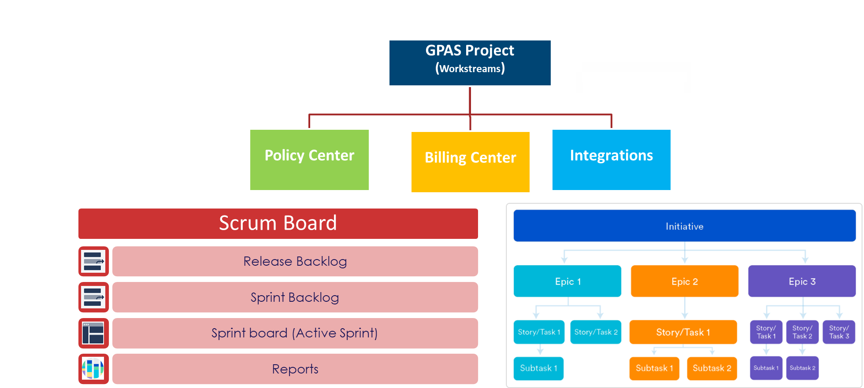
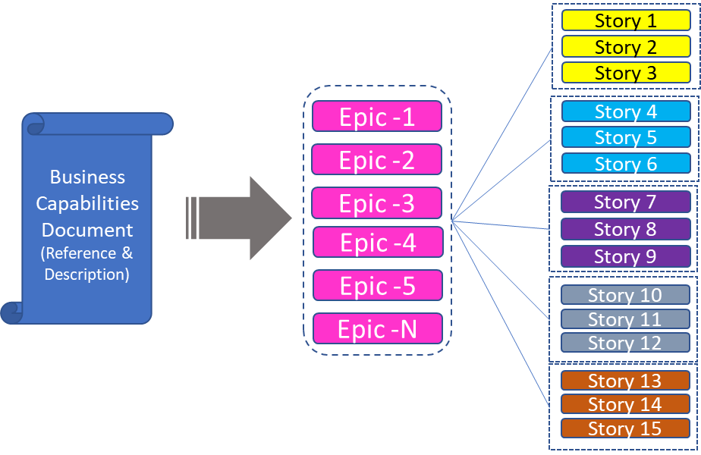
Jira Setup
Process to setup projects in Jira with one scheme configuration and upload prioritized backlog during inception phase
Step1 – Create one Schema Configuration for all GPAS projects
Step2 – Create Projects and set one scheme configuration
GPAS Projects
Screen Scheme
Workflow Scheme
Issue type Scheme
Permission Scheme
Step3 – Upload the prioritized backlog to GPAS projects
Notes:
3 mins
Cloud Assurance – feedback highest standard of code globally. Jointly work with them
GW embedded within the team
Fully connected Delivery teams
Clear points of escalation
Lean/Scalable governance model

Slide 25
Ways of working
INCEPTION PHASE FOCUSED – for start of Inception
Overall view of the Delivery phases
Scope of Inception phase
Inception phase construct – week wise split of activities & deliverables
Entry and Exit criteria
Governance – Capgemini & Beazley (key roles from Business, Capgemini, Architecture etc)
Cadence (covering US and UK time zones)
Pre-requisites & RACI
Tools for Inception
JIRA set-up and governance
BUILD PHASE FOCUSED – to be built during Inception phase
  Foundation & Waves Construct
  Backlog management process
  Sprint construct
    User story construct
    Elaboration and design phase break-up
    User story cycle
    Sprint events and RACI
    Sprint on a timeline
  Cadence and ceremonies
    Roles and ceremonies matrix
  User story management
    Scenario's illustration
  Activities list
  Definition of done and definition of ready
  Third party alignments and SLA
  Metrics
  Collaboration and Tool sets

Slide 26
Needs to be updated for beazley
Programme Communication
Communications planning and execution is a tool to clarify goals and objectives
Communications will clarify our objectives and goals for all key stakeholders
Communications will be driven by Beazley to ensure regular alignment and insight
The end-to-end communications plan will be written as input to readiness for the Discovery phase
A proposed structure/flow is shown below
NOTE: Beazley are developing a set of templates to be used for programme communications
Kick off and Alignment
Monitor Progress with business
Weekly
Senior updates
Ongoing
Engage
Updates
ASE
Check Ins
Podcasts
Project Initiation communications to engage the business
Regular comms out to business areas (e.g. All Hands calls)
Ongoing
Notes:
3 mins
Cloud Assurance – feedback highest standard of code globally. Jointly work with them
GW embedded within the team
Fully connected Delivery teams
Clear points of escalation
Lean/Scalable governance model

Slide 27
Inception & Foundation Release
Roles & Scrum team view
Beazley
Capgemini
Guidewire
Scrum Teams
Inception
Programme Lead
Delivery Lead
Architect
Functional Lead
Business Analysts
Workstream Lead
Programme Test Lead
Lead Dev Engineer
Engagement Lead
Assurance Lead
Assurance Architect
Product Owners (Policy, Billing, Integrations)
Business SMEs
E2E Programme Lead
E2E Programme Test Lead
Architects
PolicyCenter
BillingCenter
GPAS & Billing INT for UWWB
Rest of Integrations
Product
Migration
Foundation Release
Product Owners (Policy, Billing, Integrations)
Business SMEs
E2E Programme Lead
E2E Programme Test Lead
Architects
Programme Lead
Delivery Lead
Architect
Functional Lead
Business Analysts
Workstream Lead
Programme Test Lead
Scrum Master
Lead Dev Engineer
Dev Engineer
Test Engineer
DevOps
Engagement Lead
Assurance Lead
Assurance Architect
Notes:
5 to 8 mins
Talk about, we understand the need for interim & target state, possi

Slide 28
Inception programme deliverable outputs
Needs to be updated for beazley
Deliverables at programme level & expected signatories
Deliverables to be produced during Pre-Inception, ready for review and response feedback loop from Week 7 into Week 8 (end of Pre-Inception). All deliverables to have a wider review distribution which will be confirmed on the deliverable itself.
Functional Activities
Obtain an understanding of in scope functional areas
Obtain and understanding of as is current processes
Receive demos of current systems
Review the existing capability map and identify any gaps
Deliverable Names | High level Description and Expectation | Responsible | Sign Off
PD1: High Level Foundation release scope definition | Release Roadmap and confirmed Release 1 scope | CG, SFPS, TRV | Christian Kitchen Bill Devine Michael Lawton
PD2: Ways of working for Discovery | Defined and agreed governance, roles/responsibilities, structure and comms for Discovery phase | CG, SFPS, TRV | Programme Leadership Team
PD3: Rationalised product set for foundation release | Identification of outlier products or gaps in product sets requiring more analysis, driving key decision papers where required | Lead Business Architect, Senior Product Owner | Kieran O’Grady
PD4: Architecture Decision & Principles (Draft) | Draft approach to solution design, agreed principles and design patterns. | CG, SFPS TRV | Sam Kesseli
PD5: Application Architecture Blueprint (Draft) | Draft set of in-scope applications and components | CG, SFPS TRV | Sam Kesseli
PD6: High Level Product backlog | High level Epic/Feature list confirmed for Release 1 scope | Lead Business Architect, Senior Product Owner | Kieran O’Grady
PD7: e2e project plan | Pre-Inception and Discovery plan; and high level draft end to end plan | CG, SFPS TRV | DeAnna Dobosz Barry Houston
PD8: Capability map approved | Confirmed capability map aligned to Release 1 scope – This includes the visual capability map on a page and the supporting excel workbook | TRV | Kieran O’Grady Rob Harwood
Notes:
3 mins
Cloud Assurance – feedback highest standard of code globally. Jointly work with them
GW embedded within the team
Fully connected Delivery teams
Clear points of escalation
Lean/Scalable governance model

Slide 29
Inception programme deliverable outputs
Needs to be updated for beazley
Deliverables at programme level & expected signatories
Functional Activities
Obtain an understanding of in scope functional areas
Obtain and understanding of as is current processes
Receive demos of current systems
Review the existing capability map and identify any gaps
Deliverables to be produced during Pre-Inception, ready for review and response feedback loop from Week 7 into Week 8 (end of Pre-Inception). All deliverables to have a wider review distribution which will be confirmed on the deliverable itself.
Deliverable Names | High level Description and Expectation | Responsible | Sign Off
PD9: Communications plan | Reporting, frequency, expected audience and business comms required for FOS programme | CG, SFPS, TRV | DeAnna Dobosz
PD10: Functional workshop plan for Discovery | Functional workshop plan for high level requirement gathering | CG, SFPS, TRV | Kieran O’Grady
PD11: Initial version of Integration Manifest | Inventory of any integrations and intermediary services including definitions, ownership, high level design etc | CG, SFPS, TRV | Sam Kesseli
PD12: Technical Workshop plan | Technical workshop plan to gather and define integration requirements | CG, SFPS, TRV | DeAnna Debosz Barry Houston Rob Harwood
PD13: High-level end to end customer journey map | The high-level future state processes and end-to-end journey for the identified personas. The journey map will highlight the key touchpoints for the identified personas across the customer lifecycle and will be an input to the Capability Map and product backlog. Refinement of the future state Blueprint and Wireframes to be conducted during Discovery. Document describing how the capabilities from the e2e customer journey map will be delivered through the Application | SFPS, TRV | Mark Wright Kieran O'Grady
Notes:
3 mins
Cloud Assurance – feedback highest standard of code globally. Jointly work with them
GW embedded within the team
Fully connected Delivery teams
Clear points of escalation
Lean/Scalable governance model

Slide 30
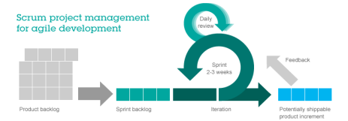
TEAM STRUCTURE
ALTERNATIVE TO SLIDE 7 - Needs to be updated for beazley
Executive Leadership
Capgemini Exec Sponsor
Steering Committee
Executive Sponsors
Program Leadership
PMO
Programme / Delivery
Management
Architects
Product Owner(s)
Consultants
PMO
Programm
Functional
Leads
Functional Lead
Configuration Lead
Integration Lead
Data Lead
Test Manager
Infrastructure Lead
OCM Lead
Test Lead
Test Lead
Leaders ensure alignment between Scrum teams
Technical
Leads
Policy
Billing
Integration
Test Leads
UAT
Release Manager
Onshore
Scrum Master
Business Analysts
Dev Lead
Product Owner
Business SMEs
Developers
GW Consultants
Business Analyst
Tech Lead
Developers
Testers
PC Conv Dev
Scrum Master
Business Analysts
Product Owner
Business SMEs
Developers
GW Consultants
Tech Lead
Developers
Testers
Scrum Master
Integration Dev
Integration Dev
Technical SMEs
Developers
GW Consultants
Mapping Analyst
Tech Lead
Developers
Testers
Delivery Teams
Offshore Delivery Lead
Test Lead
LEGEND
Offshore
Beazley
Capgemini
Sapiens
Scrum Team
Automation Testers / Performance Testers
Notes:
3 mins
Cloud Assurance – feedback highest standard of code globally. Jointly work with them
GW embedded within the team
Fully connected Delivery teams
Clear points of escalation
Lean/Scalable governance model

Slide 31
Team for inception
Needs to be updated for beazley
High Level View – detailed project team chart to be found on next slide
Programme Leadership
Steering Committee
Greg Toczydlowski
Maria Olivo
Mojgan Lefebvre
Jeff Klenk
Mike Lawton
FOS Business Owner
Christian Kitchen
FOS EUR Programme Lead
Kieran O’Grady
Programme Business Lead
DeAnna Dobosz
Programme Director
Rob Harwood
Programme Technical Lead
Sponsor(s)
Matthew Wilson
FOS Programme Sponsor
Bill Devine
Business Capabilities, BI
Bryan Bonadies
Intl CIO
Barry Houston
Capgemini Programme Director
Brett Fabian-Smith
Lead Enterprise Architect
James Dale
Capgemini Programme Manager
Mary Engdahl
Salesforce Engagement Lead
Key Stakeholders
Chris Allison
BI Specialty
Heather Batchelor
CUO, BI
Mike Byam
B&SI Project Manager
Kevin De Sa
Digital Enablement
Bill Devine
Execution Leadership Support
Jon Davies
Bond & SI International
Andrzej Kobus
Ent Archt & Emerging Tech
Jane Marrison
Information Management
Pete McConnell
Finance Europe
Emma Scopino
SP&E and CX BI
Maryellen Szwez
Int’l Programme Lead
Greg Toczydlowski
President, BI
Technology
Rob Harwood
Technical Design Authority Lead
Design Authorities
Kieran O’Grady
Business Design Authority Lead
Business
Sam Kesseli
Lead Architect
Andy Wilkins
Software Engineering EUR
Dean Martin​
Lead Architect EUR
Specialty
Underwriting & Portfolio Mngmnt
Operations
Regulatory & Compliance
Jamie Jones
iHUB Fos Circle Lead
Harsha Chinnam
iHUB FoS Tech Lead
Bradley Todd
Int’l Info Architect
TBD
Data Tech Lead
Finance & Reinsurance
B&SI
Actuarial & CAT
Claim
Brett Fabian-Smith
Lead Enterprise Architect
Tim Warburton
Salesforce Programme Architect
Aurobinda Mahapatra
Integration Architect
Peter Dixon
Business Architect
Segun Odubiyi
PC Functional Lead
Sriram Jagannathan
BC Functional Lead
Mark Conlan
SF User Experience
Salman Sheikh
Salesforce Solution Architect
Prasanna Kumar
Data Architect
Vamshi C
Guidewire Architect
Notes:
3 mins
Cloud Assurance – feedback highest standard of code globally. Jointly work with them
GW embedded within the team
Fully connected Delivery teams
Clear points of escalation
Lean/Scalable governance model

Slide 32

Needs to be updated for beazley
Delivery Management
Capgemini resources (C)
Salesforce resources (S)
Start in Discovery Phase
Team interfaces
Programme Sponsorship
Matthew Wilson – FOS Programme Sponsor
Steering Committee
Bill Devine - Executive Leadership Support
Christian Kitchen - EUR Programme Lead
Michael Lawton - FOS Business Owner
Delivery Leadership
Transformation Delivery Office
Vendor Representation
DeAnna Dobosz - Programme Director
- Richard Kelley - Business Benefits
- Denise Cunningham - Comms Lead
- Pete McConnell – Finance
- Ben Cagne – Procurement
- Julie Foster - Human Resources
- Imran Shah - Risk & Compliance
Vishala Ravipati – Capgemini
Simon Woolrych – Salesforce
Jamie McDonnell – Guidewire
Barry Houston( C)
Programme Director
Rob Harwood
Programme Technology and Data Lead
Kieran O’Grady
Programme Business Lead
Surya Malladi (C)
Senior Product Manager
TBC
Programme Management Office
James Dale ( C)
Programme Manager
Brett Fabian-Smith ( C)
Lead Enterprise Architect
Mary Engdahl (S)
Salesforce Engagement Lead
Alida Liebenberg
Senior Product Manager
Product Owners report into Senior Product Manager
Sales and Distribution
Pre-Bind Underwriting
Rating and Pricing
Post Bind/PAS/Servicing
Billing and Settlement
Claims
Accounting Rules / Sub L.
Outwards RI
Data Migration
Stephen McKenna
Product Owner
Vanessa Hill
Product Owner
Tom Goddard
Product Owner
Nelly Grelet
Product Owner
Paul Colin
Product Owner
Judy O’Neill
Product Owner
Paul Colin
Product Owner
Callum Rainy-Brown
Product Owner
TBC (C)
Data Mig. Lead
Business Architecture, Functional Design and User experience
Peter Dixon (C) – Lead Business Architect
James Simpson - Senior Business Architect
Colin Small – Business Architect
Mark Wright – UX Lead
Clare Bodrell – Business Analyst Manager
Jamie Hawkins –Senior Business Analyst
Rajeev Jindal (C) - Functional Lead – Sales, Distribution, UW and Pricing
Halim Mahah (C)- Business Analyst 1
Sriram Jagannathan
(C) - Business Design Lead – Policy Admin, Servicing, Billing and Claims
TBC (C) - Business Analyst 1
TBC (C) - Business Design Lead – Accounting Rules and Outwards RI
Arun Kumar (C) - Business Analyst 1
Covered by wider team in Pre-Inception
People, Change & Culture
TBC – Change Lead
Steve Chatwin - Training Lead
Rob Harwood Programme Technology Lead
- Sam Kesseli
Intl Lead Architect
- Stephen Campling (C) Programme Solution Architect
- TBC (C) Programme Data Architect
Angie Rios – SF Product Owner +
Sudheer Sura – Salesforce Platform (Tech) Lead
Mary Engdahl (S) – Engagement Lead
Benjamin Fairclough (S) – Senior Project Manager
Tim Warburton (S) – Salesforce Programme Architect
Ad-hoc Support
Covered by wider team in Pre-Inception
Salesforce inc SF Design / BA
Salman Sheikh (S)
Solution Architect
Mark Conlan (S)
Senior Experience Architect
Sindhu Talreja (S)
Solution Consultant
Integration Design / BA
Aurobinda Mahapatra (S) – Integration Lead
Capability Guilds
Guidewire inc GW Design / BA
Lorraine Shakesheff (C) – Guidewire Delivery Lead
Denise Wood – Guidewire Platform Owner
Vamshi Chennamadhavuni (C) – Guidewire Enterprise Architect
Segun Odubiyi (C) – PolicyCenter Functional Lead
Arun Showry Pudhota (C) – PolicyCenter Technical Lead – Sales & D, Pre-Bind UW
TBC (C) – PolicyCenter Technical Lead – Rating & P, Post Bind/PAS / Servicing
Rupesh Gutula (C) – BillingCenter Functional Lead
KV Balaji (C) – BillingCenter Technical Lead
Covered by wider team in Pre-Inception
Covered by wider team in Pre-Inception
Technology and Data
Beazley Tech Design & Delivery (+downstream)
Andy Wilkins – Engineering Lead
Vijay Srinivasan – Platform Architect (incl. SF)
TBC - Infrastructure Architect
Data, MI and analytics
Jamie Jones - Data, MI and Analytics Lead
Harsha Vardhan Chinnam – Data Technology Lead
Venkata Konda - Data Governance Lead
Pee T. Lim – Data Architetct INTERIM
TBC (C) –Data Lead
Tony Lewis – MI & Analytics Lead
Bradley Todd - Information Architect
TBC – Finance Data Lead
Testing
Discovery onwards - TBC
Distribution / Customer
Steve McKenna – Distribution Lead
Graham Taylor – CRM (BI Retail) Lead
Underwriting, RI and Portfolio Mgmt
Shanda Davis– BSI UW Lead
Vanessa Hill – BI UW Lead
Callum Rainy-Brown - RI
Elio Buffa -Portfolio Mgmt
Owain Lloyd – Catastrophe Management
Pricing
Tom Goddard – Product Owner
Business Subject Matter Experts
Operations
Nelly Grelet – Operation - Post Bind / PAS / Servicing Product Owner
32
Finance
Paul Colin – Billing and Settlement Product Owner
Claims
Judy O’Neill – Claims Product Owner
Notes:
3 mins
Cloud Assurance – feedback highest standard of code globally. Jointly work with them
GW embedded within the team
Fully connected Delivery teams
Clear points of escalation
Lean/Scalable governance model

Slide 33
TEAM STRUCTURE
ALTERNATIVE TO SLIDE 7 - Needs to be updated for beazley
Executive Leadership
Capgemini Exec Sponsor
Steering Committee
Executive Sponsors
Program Leadership
PMO
Programme / Delivery
Management
Architects
Product Owner(s)
Consultants
PMO
Programm
Delivery Teams
Functional Lead
Configuration Lead
Integration Lead
Data Lead
Migration Lead
Test Manager
Infrastructure Lead
OCM Lead
Test Lead
Test Lead
Leaders ensure alignment between Scrum teams
Policy
Claims
Billing
Integration
Data
Migration
Test Leads
UAT
Release Manager
Onshore
Scrum Master
Business Analysts
Dev Lead
Product Owner
Business SMEs
Developers
GW Consultants
Business Analyst
Tech Lead
Developers
Testers
PC Conv Dev
Scrum Master
Business Analysts
Dev Lead
Product Owner
Business SMEs
Developers
Business Analyst
Tech Lead
Developers
Testers
Business Analysts
Product Owner
Business SMEs
Developers
GW Consultants
Tech Lead
Developers
Testers
Integration Dev
Integration Dev
Technical SMEs
Developers
GW Consultants
Mapping Analyst
Tech Lead
Developers
Testers
Data Architect
Product Owner
Technical SMEs
Data Analyst
ETL Developers
DataHub Developers
Testers
Product Owner
Technical SMEs
Migration Analyst
Migration Developers
Testers
Offshore Delivery Lead
Test Lead
LEGEND
Offshore
Beazley
Capgemini
Sapiens
Scrum Team
Automation Testers / Performance Testers
Notes:
3 mins
Cloud Assurance – feedback highest standard of code globally. Jointly work with them
GW embedded within the team
Fully connected Delivery teams
Clear points of escalation
Lean/Scalable governance model

Slide 34
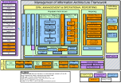
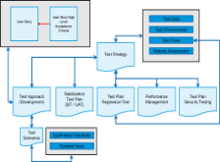
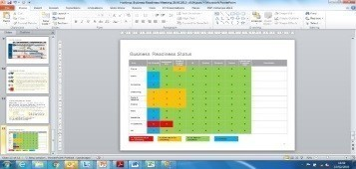
How we will deliver together
Our Delivery framework is based on incremental build, early integration, robust end-to-end quality assurance and early business validation
Iterative for each Release
Pre-Inception
Inception
Design and Build
(Sprint Agile)
Stabilization
Hyper care
Initial Estimates
Integrated Programme plan
Prep. Release
Missions / OKRs
Product Backlog
Sprint
Retrosp.
Sprint
Review
Sprint
Plan
Application
Architecture
User stories
Training Users
Testing
Elabora-
tion
Config. &
Devel.
Acceptance
Ways of Working
Estimates
Product Rationalization
Sprint Plan
Release in Production
Outcomes / Enables
Env. / Test Strategy
User stories for
OOTB Functionalities
The software is developed during each sprint; tested and usable components are delivered
End to End Testing
App. Access
Validation
Transition from the Programme team to the Operations / Support team
Integration Inventory
High level Integration Design
Early E2E & NFR Testing where possible
Performance Testing
Early and continuous acceptance of the delivered Software Business (Early Business Validation)
Trained Users (OCM)
Business Change
Refinement of Estimates
Refinement of Estimates
NFR/OAT Testing
Hypercare support (incident analysis, correction and testing)
Internal Knowledge Sharing & Retrospection
Early Business Validation
Business
Acceptance
Our methodology accelerates the start of large implementations through the reuse of templates, assets and accelerators, obtained from experience
of core insurance implementations at a global level.
Notes:
4 mins
Robust, tried and tested for GW, taken our experience from 100s of implementations & is based on SAFe
Global delivery methodology
Combination of taking what we have learnt in Pre-Inception, leverage existing GW OOTB / Product Backlog & series of accelerators
We have proven Agile methodology , which we’ll adapt our methodology to specific insurer
Ultimately it’s about best practices, concept of ‘Shift left’, robust frameworks & iterative development

Slide 35
Org STRUCTURE for inception & Foundational Release
ALTERNATIVE TO SLIDE 7 - Needs to be updated for beazley
Capgemini XXXX
Vanessa Ortega (Business Owner)
Warren Pilkington (Delivery Lead)
Dauda Jammeh (Fiinance Business Owner)
Joe Bate-Williams(Finance Modernisation Lead)
Core Team
SMEs
Billing SMEs (Operations, Receivables, Payable, Finance) - 50%
Global PAS Platform/ Product Lead (Jeff P)
Business Architecture
Lead (Matt PT 50%)
SI Delivery Lead
Workbench Workflow/ Process SME- 50%
Customer Service (Ops) Process (Appian) SME - 50%
Enterprise Architect Lead (Dean P)
Change Management Lead (C)
Solution Architect
Rating/ Actuarial SME for D&O and T1 - 25%
Migration (Legacy PAS SMEs) - 50% (Multiple)
Billing Lead (Athik P)
Training /
Communication (PT 15%)
Technical Lead
Customer/Account Data Management SME - 25%
Product SME (e.g. D&O T1) - 50% (Troy B +1)
Release Train Engineer/ Manager (Stephen C)
PMO Analyst (Lewis P)
PAS QA / Test Lead
Agency Management SME - 20%
Claims SME - 20%
Guidewire Roles (TBA)
Delivery Organisation
Integrations Squad 1
Integrations Squad 2
Data Squad
Infrastructure Squad
Billing Squad
Product Squad 1 - Core Platform
Product Squad 2 - D&O
Product Squad 3 – Tranche 1
Tech Architect / Lead
Tech Architect / Lead
Data Migration Lead
Infrastructure Lead
Functional Lead
Functional Lead
Functional Lead
Functional Lead
Shared Services - IT Security, Risk/Audit, Compliance
Scrum Master
Scrum Master
Data Lead/Architect
Infrastructure Architect
Scrum Master
Scrum Master
Scrum Master
Scrum Master
Developer
Developer
Developer
DevOps Engineer (s)
Product Owner
Product Owner
Product Owner
Product Owner
Quality Assurance
Quality Assurance
Quality Assurance
Technical Analyst / Tester
Business Analyst
Business Analysts
Business Analysts
Business Analyst
PAS BAU transition team (dependent on Beazley’s ITOM/ BAU service management structure)
Business Analyst
Business Analyst
Data Analyst
Developer
Developer
Developer
Developer
QA Tester
QA Tester
QA Tester
QA Tester
Beazley Resource
SI Resource
35
Notes:
3 mins
Cloud Assurance – feedback highest standard of code globally. Jointly work with them
GW embedded within the team
Fully connected Delivery teams
Clear points of escalation
Lean/Scalable governance model

Slide 36
KEY ROLES - capgemini
Needs to be updated for beazley
Role | Named resource | Description
Engagement Director | Barry Houston | Responsible for overall Services quality and delivery Assist in the resolution of issues and change controls | Prepare for and support Steering/Policy Executive Advisory Group Meetings Monitor program progress
Programme Manager | James Dale | Responsible for in-scope Program activities Provide Program status reporting on a regular basis to Beazley Program and Executive Leadership | Responsible for overall Services quality and delivery of the Program Responsible for day-to-day management and tracking of the in-scope Program activities
Delivery Lead | Lorraine Shakesheff | Manage the detailed Program plan in collaboration with Beazley Leadership Team Provide Program Status reporting on a regular basis to Beazley Program Leadership | Facilitate Decisions, Issues and Risk management across the core program and escalate to Beazley in advance of the materialization of potential risks and issues that may delay the program. Assist the resolution of issues and change controls
Business Lead | Peter Dixon | Provide subject matter specialist advice with regard to overall business requirements and product backlog Provide input on solving business problems within the defined application landscape by working with the business and Technical resources. | Coordinate with Functional Lead and Technical architect to help define implementation scope of work.
Enterprise Architect | Brett Fabian-Smith | Provide leadership and architectural expertise across a broad set of technologies, including integration & middleware technologies Consult with and advise the Program team on technology and strategic decisions | Identify architectural constraints for the architectural level (project, domain, application) based on technical and organizational requirements Provide subject matter specialist advice with regard to overall solution architecture and technology
PolicyCenter Functional Lead | Segun Odubiyi | Provide Policy subject matter experience Work with Beazley business leadership to drive overall business requirements | Provide leadership and direction for elaboration and RSWs Provide joint review and approval of deliverables
BillingCenter Functional Lead | Sriram Jagannathan | Provide Billing subject matter experience Work with Beazley business leadership to drive overall business requirements Provide leadership and direction for elaboration and RSWs | Provide joint review and approval of deliverables Lead with the high-level implementation approach for complex functional requirements
PolicyCenter Technical Lead | Vamshi Chennamadhuveni | Provide subject matter specialist advice with regard to GW PC Conduct configuration option analysis to support business requirements Provide input on GW PC best practices, constraints, and effort during workshops, including pre-work | Provide input on effort and impact associated with potential configurations/customizations Support the Policy Functional Lead with the high-level implementation approach for complex functional requirements
BillingCenter Technical Lead | Balaji KV | Provide subject matter specialist advice with regard to GW BC Conduct configuration option analysis to support business requirements Provide input on GW PC best practices, constraints, and effort during workshops, including pre-work | Provide input on effort and impact associated with potential configurations/customizations Support the Policy
Integration Lead | Gourab Marik | Provide integration and technical architecture guidance for GW Lead analysis effort of interface specification documents | Lead the integration design effort for specified integration points Provide direction and technical guidance
Notes:
3 mins
Cloud Assurance – feedback highest standard of code globally. Jointly work with them
GW embedded within the team
Fully connected Delivery teams
Clear points of escalation
Lean/Scalable governance model

Slide 37
KEY ROLES - guidewire
Needs to be updated for beazley
Role | Named resource | Description
PolicyCenter Principal Architect | Bruno Fauchere | PolicyCenter technical architect
PolicyCenter Principal Business Analyst | Ron Wedderburn | PolicyCenter functional and product expert
BillingCenter Principal Architect | Stephen Hathaway | BillingCenter architect
Integration Principal Architect | Ian Baxter | Guidewire Integration architect
London Market Specialist | Paul Abbott | Guidewire London Market and product architect
Guidewire Delivery Management (non-billable part time role) | Tom Mann | Guidewire point of contact for the implementation and Guidewire assigned resourcing.
Guidewire Product (non-billable part time role) | Mark Rouse | Guidewire London Market expert and point of liaison with Guidewire product team. Needs to understand the business needs so that any future Guidewire product related enhancements can be planned.
Guidewire Product (non-billable part time role) | Paul Mallett | Guidewire London Market expert and point of liaison with Guidewire product team. Needs to understand the business needs so that any future Guidewire product related enhancements can be planned.
Notes:
3 mins
Cloud Assurance – feedback highest standard of code globally. Jointly work with them
GW embedded within the team
Fully connected Delivery teams
Clear points of escalation
Lean/Scalable governance model

Slide 38
KEY ROLES – Beazley
Needs to be updated for beazley
Role | Named resource | Description
Steering Committee | Greg Toczydlowski, Maria Olivo, Mojgan Lefebvre, Jeff Klenk | Future focused governing body that provides strategic direction, participates in development of business vision, makes material budget, scope, and timing decisions and monitors program progress to ensure alignment with overall program objectives.
Sponsors | Bill Devine, Christian Kitchen, Mike Lawton | The sponsor is accountable for ensuring that the work is governed effectively and delivers the objectives that meet identified needs
EUR Programme Lead | Christian Kitchen | Accountable for the success of the project and owner of the Business case. Attends the steering committee and expedites key decision making process.
FOS Business Owner | Michael Lawton | Accountable for the success of the project and owner of the Business case. Attends the steering committee and expedites key decision making process.
Programme Director (Execution) | DeAnna Dobosz | Responsible for end to end programme delivery, prioritisation; alignment to business outcomes, and delivery of business capabilities.
Programme Business Lead | Kieran O’Grady | Accountable for business outcomes, making program business decisions and setting program business priorities.
Senior Product Manager | Alida Liedenberg | Overall Product Manager with oversight across all the various business areas and individual Product Owners. With support from the Product Owners, will give steering recommendations on decisions to the Programme Business Lead.
Product Owners – Various | Various | BAU owner of the product with the overall decision making authority of the product. Provide function and product requirements. Development and prioritization of the User Stories / Backlog with the scrum master.
Programme Technology and Data Lead | Rob Harwood | Accountable for alignment to technical architecture roadmap and overall technical delivery.
Data, MI and Analytics Lead | Jamie Jones | Accountable for alignment to data and MI outcomes, making programme level decisions and setting data and MI priorities at this level.
International Lead Architect | Sam Kesseli | Accountable for Architecture and technology strategy.
Change Lead | TBD – for future phase | Develops Change Plan for stakeholders, communications plan, and oversight of Change Management activities.
Training Lead | Steve Chatwin | Develop Training Plan, Training Materials and oversight of execution of Training delivery
Finance Lead | TBD – for future phase | Accountable for alignment to Finance outcomes, making programme level decisions and setting Finance W/S priorities at this level.
Data Migration Lead | TBD – for future phase | Accountable for alignment to data migration outcomes, making programme level decisions and setting data migration priorities at this level. Works very closely with the Technology and Data leads.
Test Lead | TBD – for future phase | Overall Test Lead, responsible for Test Strategy, Test scope, end to end engagement with business and exit gate criteria and sign offs.
Notes:
3 mins
Cloud Assurance – feedback highest standard of code globally. Jointly work with them
GW embedded within the team
Fully connected Delivery teams
Clear points of escalation
Lean/Scalable governance model

Slide 39
Decision authority levels
Needs adding to e.g. design etc for beazley
Impact |  | Workstream Leads | Program Directors | Steering Group | Other…
Time (Level 0) | Affect or may affect the Level 0 Plan | ü | ü | ü
Time (Level 1) | Affect or may affect the Level 1 Plans | ü | ü | û
Scope | Affect Programme Scope | ü | ü | ü
RAID | Workstream | ü | û | û
RAID | Program Leads | ü | ü | û
RAID | Overall Programme | ü | ü | ü
Notes:
3 mins
Cloud Assurance – feedback highest standard of code globally. Jointly work with them
GW embedded within the team
Fully connected Delivery teams
Clear points of escalation
Lean/Scalable governance model

Slide 40
inception phase
INCEPTION KEY ACTIVITIES – to be fine tuned
Start-up &
Visioning
Capability & Scope Analysis (Business Architecture)
Technical Architecture
and Analysis
Implementation
Planning
Test
Strategy
Project Kick-off and On-boarding
of Resources
Develop Policy Core Implementation Project Charter and Governance Plan
Update Roles and Responsibilities
Assist with updated Stakeholder Analysis\Setup of Project
Management Tools
Develop initial Project Plan – Project Increments, Sprints
Prepare for and conduct Executive Stakeholder visioning session
Understand high level Target
Operating Model
Understand current state policy “as-is” Business Processes, supporting data, and
supporting technology
Identify key business process re-engineering areas based on business priority, business function and capability, and leading practices
Define Future State “to-be” business processes, supporting data, and supporting technology
Define functional and non-functional requirements for GPAS Implementation
Define high-level operational reporting and analysis requirements
Provide architectural support based on best-of-breed Enterprise Policy Architecture practices.
Define a Policy Technical Architecture Framework to cover the GW Policy Platform & its related integration points
Facilitate technology alignment with the strategic intent of the business, ensures IT resources are used responsibly & technology architecture related risks are actively managed
Identify and document future state transactions inventory & trigger points.
Define, validate and refine Policy Data Conversion approach to cover – open Policy, closed Policy-in-retention & closed Policy for migration to target system.
Conduct high-level source data profiling to validate the overall approach based on target data model.
Define, validate and refine the legacy system decommissioning approach
Produce a Developer on-boarding kit including tool access, standards information
Define estimates for the Implementation effort for the Policy Core Implementation Project initiatives. Detailed estimates for the Policy Core and related integration components for the Policy Core Implementation Project Implementation Phase.
Detail the timeline and activities to implement the Policy Core platform and its related integration components
Define the dependencies between the various Policy Core Implementation Project initiatives
Set objectives of quality management activities and document the test objectives in a measurable format
Identify the different phases of testing required and define approach and Entry and Exit criteria
Define Test Environment requirements
Define Test Data requirements
Define test process, communication procedures, reporting process and governance procedures for the entire project life cycle.

Slide 41


Programme governance model
We will implement a 3-in-a-box Executive Governance structure including Beazley, Capgemini and Guidewire.
Governance
Activities
Programme Sponsor
Business & IT Executives
Programme Director
Programme Sponsor
Account & Delivery Executive
Programme Director
Account Executive
Guidewire Executives
Cloud Assurance
Define Strategy
Reviews & Prioritization
Overall delivery oversight
Budget approvals
Dashboard (KPI) Reviews
Resolution of Escalations
Quarterly/Monthly
Critical Issue Resolution
Strategic
Steering Committee
E2E Programme Lead
Product Owners
Business SMEs
Architects
Programme Lead
Delivery Lead
Architects
Functional Leads
Workstream Leads
Engagement Lead
Assurance Lead
Assurance Architect
Manage Risk/Issues & impact
Capacity Management
Relationship Management
Prioritization
Change Control Board
Programme Management
Monthly/Weekly
Contingency Planning and Risk mitigation
Tactical
E2E Programme Test Lead
Product Owners
Business SMEs
Architects
Programme Test Lead
Scrum Master
Integration Lead
Lead Dev Engineer
Business Analysts
Architects
Dev Engineer
Test Engineer
DevOps
Project level Reporting
Execution (day-to-day work)
Resolve operational issues
Review Weekly Status
Daily stand-up meetings
Daily/Weekly
Programme Delivery
Operational
Issue Escalation
01
02
03
04
Make work visible
Trust our teams
Remove friction
Learn with feedback
Notes:
3 mins
Cloud Assurance – feedback highest standard of code globally. Jointly work with them
GW embedded within the team
Fully connected Delivery teams
Clear points of escalation
Lean/Scalable governance model

Slide 42
INCEPTION – BY WEEK STRUCTURE - ILLUSTRATIVE
The Inception plan will be shared separately for Beazley’s review and approval showing the day-wise plan
Week 1
Week 2
Week N..
Week 11
Week 12
Tuesday
(AM: 10-12:30
PM-13:30-17:00)
Policy center Overview
Team Introductions
Ways of Working
Workstreams
Foundation Scope
Inception Plan
PolicyCenter Overview
PC OOTB Value Chain Flows
Product Model/APD Overview
Beazley Target State Process Flows
Beazley Target State Architecture Diagram
Product Model: Cyber
Product Model: D&O
New Submission
  Rating (incl. Tax & Fees)
  Quote Summary
  Policy Review
  Document Generation
  Document Distribution
Integrations: UWWB, BillingCenter
Policy Change
  Initiation of Policy Change
  Rating (incl. Tax & Fees)
  Document Generation
  Close Options
Integrations: UWWB, BillingCenter, Imburse, DPS
Account & Policy File Summary & Tools
Search
Activity Patterns
History Events
Desktop
Actions
Business Admin
Wednesday
(AM: 10-12:30
PM-13:30-17:00)
Roles & Responsibilities;
Product Rationalisation;
Product Roadmap
Account
  Name Clearance
  Create New Account
  Broker Validation
  Customer Enrichment
  Sanctions
  Licensing
Integrations: CRM, Producer Management System, External Contact System
New Submission
  Submission Clearance
  New Submission
  Offerings
  Pre-Qualification Questions
  Product Model Selection
Integrations: UWWB
Renewals
  Pre-Renewal Direction
  Automatic vs Manual Renewal
  Claim History
  Payment Status
  UW Referrals & Declines
  Pre-emption
  Rating (incl Tax & Fees)
  Document Generation
  Close Options
Integrations: Imburse, ClaimCenter, BillingCenter, UWWB, DPS
Organization Model
  Groups
  Users
  Roles
  Permissions
  Authority Profiles
  Authority Limits
Teams Tab
Producer
  Producer Codes
  Producer Code Security
  Bulk Producer Change
New Submission
  Payment Schedule
  Capture Payment Method
  Bind & Issue
  Close Options
Integrations: UWWB, BillingCenter, Imburse, DPS
Quick Quote
Coinsurance
Reinsurance
Subjectivities
Thursday
(AM: 10-12:30
PM-13:30-17:00)
HL Architecture
Key Decisions
Outstanding Actions
Capability Model (draft)
Project Roadmap
New Submission
  Basic Data Capture
  Claims History
  Risk Data Capture
  UW Referrals & Declines
  Risk Analysis
  Quote Versions
Policy Change
  Premium vs Non-Premium Impacting MTA
  Out of Sequence MTA
  Pre-emption
Integrations: UWWB
Cancellation
  Schedule Cancellation
  Cancel Now
  Rescind
Reinstate
Rewrite
Integrations: UWWB, ClaimCenter, DPS
Document Management
Contact Management
Integration: ClaimCenter, DMS
User Setup
  Roles
  Permissions
Org Structure
  Teams

Slide 43
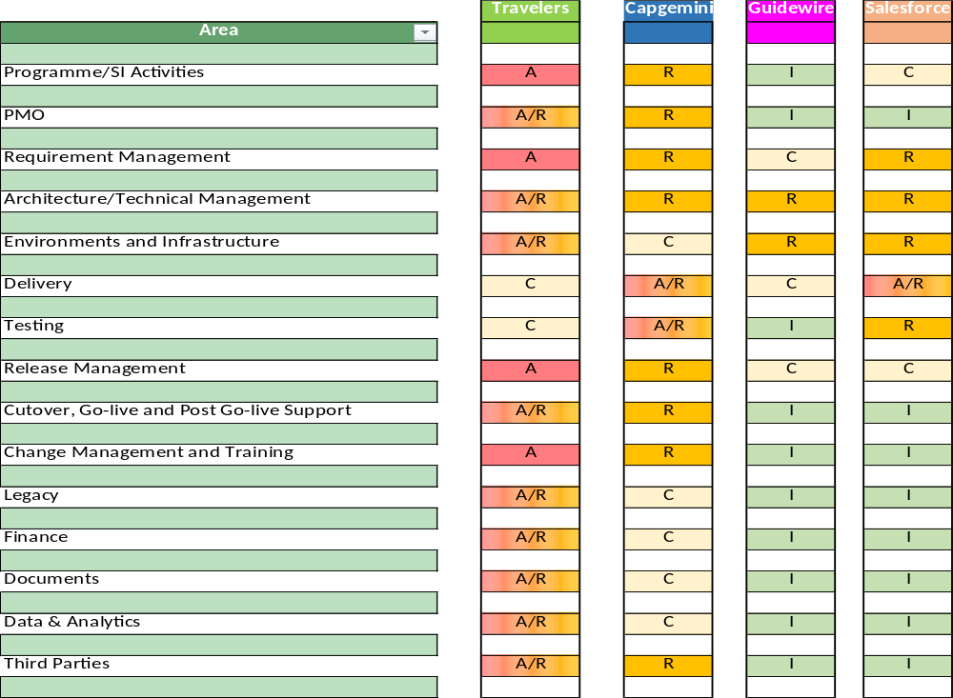

KEY ROLES - raci
Needs to be updated for beazley – source attached
RACI has also been broken down further into detailed responsibility lines. Please see attachment below for further details
Detailed RACI:
Relevant for Pre-Inception
Initial look ahead for future phases
Key
A | Accountable | Authority and decision making
R | Responsible | Responsible for actualisation of the task
C | Consulted | Engaged stakeholder, consulted in decisions, delivery and approach to enable their input
I | Informed | Informed stakeholder receiving updates and outputs only
Notes:
3 mins
Cloud Assurance – feedback highest standard of code globally. Jointly work with them
GW embedded within the team
Fully connected Delivery teams
Clear points of escalation
Lean/Scalable governance model

